Slide 1
Hypothesis Tests

Slide 2
Typical statistical analysis procedure
Visually inspect the data.
Find extreme samples, and check them carefully.
Determine the data-type (continuous or discrete) of the values.
If the data are continuous, check whether or not they are normally distributed.
Select and apply the appropriate test, or start with the model-based analysis of the data.

Slide 3
Data Screening and Outliers
The ﬁrst step in data analysis is the visual inspection of the data.
If the data are properly displayed, trends that characterize the data can be clearly visible.
It is recommendable to check for missing data and outliers.
There is no unique deﬁnition for outliers.
However, for normally distributed samples they are often deﬁned as data that lie either more than 1.5*IQR (interquartile range), or more than two standard deviations, from the sample mean.
Note: Explain about finding Outliers in detail (refer UNIT-III notes)

Slide 4
Data Screening and Outliers
Outliers often fall in one of two groups:
They are either caused by mistakes in the recording, in which case they should be excluded;
They constitute very important and valuable data points, in which case they have to be included in the data analysis.
To decide which of the two is the case, you have to check the underlying raw data (for saturation or invalid data values), and the protocols from your experiments (for mistakes that may have occurred during the recording).
If an underlying problem is detected, then—and only then—one may eliminate the outliers from the analysis.
In every other case, the data have to be kept!

Slide 5
Normality Check
Is the set of observations normally distributed?
Normality check is important as many statistical inference techniques assume that the data is following distribution

Slide 6
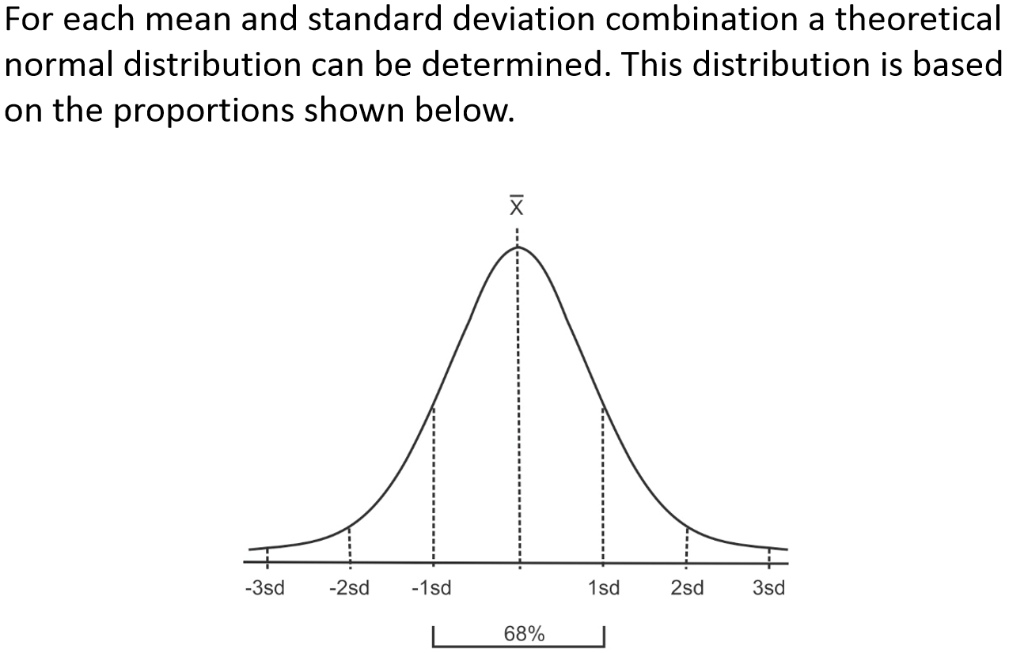
Normality Check

Slide 7
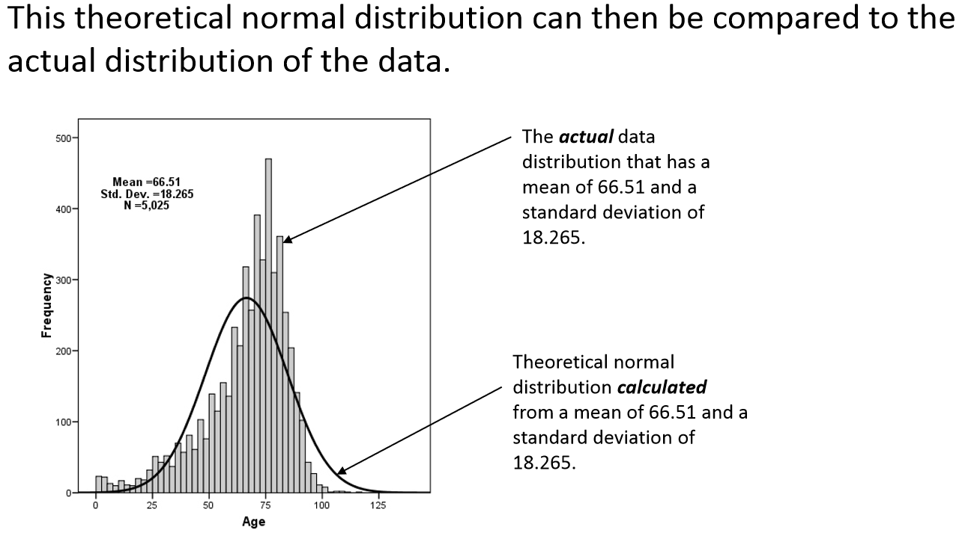

Slide 8
Normality Check
There are several methods of assessing whether data are normally distributed or not.
In statistics different tools are available for the visual assessments of distributions.
They fall into two broad categories:
graphical :
Q-Q plots
Cumulative frequency (P-P) plots
Probability plots
Statistical:
•W/S test
•Jarque-Bera test
•Shapiro-Wilks test
•Kolmogorov-Smirnov test
•D’Agostino test

Slide 9
Graphical methods for Normality check
A number of graphical methods exist for comparing two probability distributions by plotting their quantiles, or closely related parameters, against each other.
Some common techniques are:
Q-Q plots
Cumulative frequency (P-P) plots
Probability plots

Slide 10
Graphical methods
QQ-Plots: The “Q” in QQ-plot stands for quantile. The quantiles of a given data set are plotted against the quantiles of a reference distribution, typically the standard normal distribution.
PP-Plots: Plot the CDF (cumulative-distribution-function) of a given data set against the CDF of a reference distribution.
Probability Plots: Plot the ordered values of a given data set against the quantiles of a reference distribution.

Slide 11
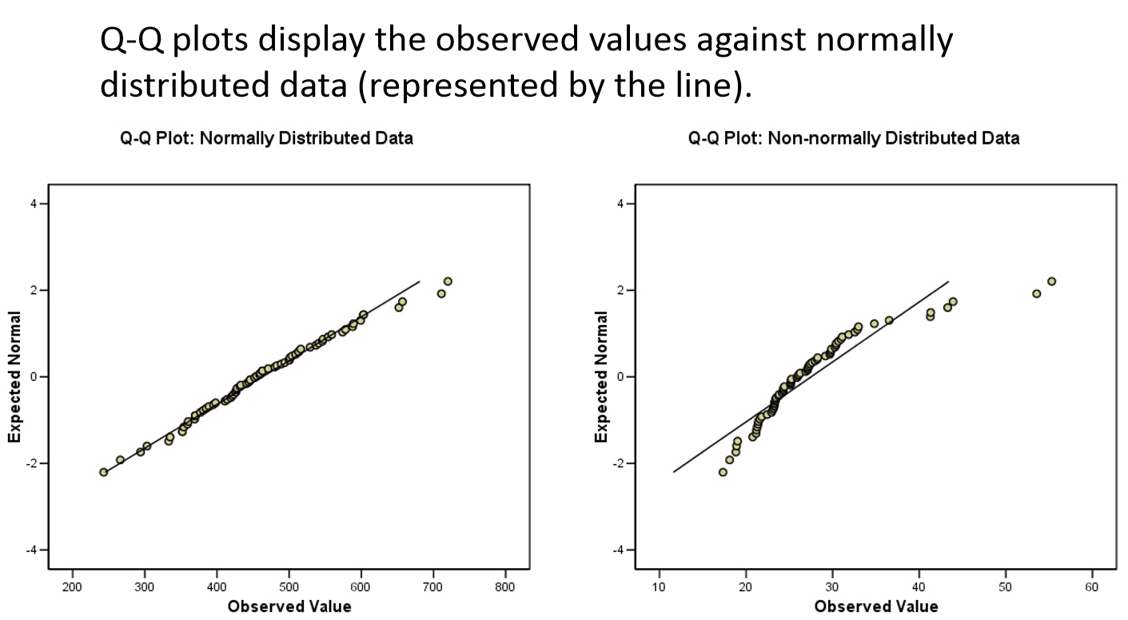

Slide 12
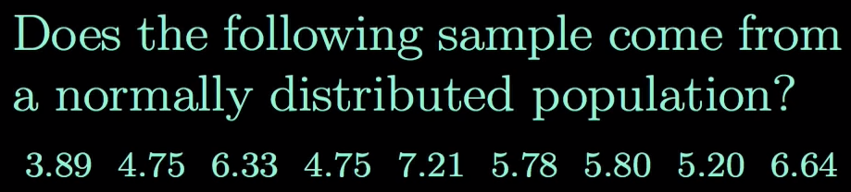
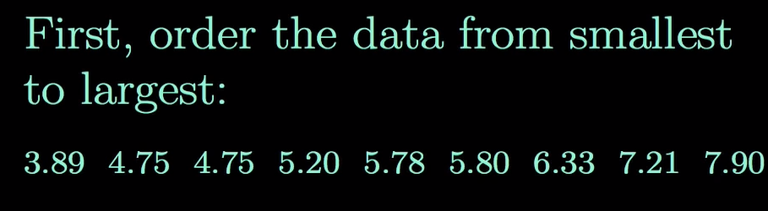

QQ Plot

Slide 13
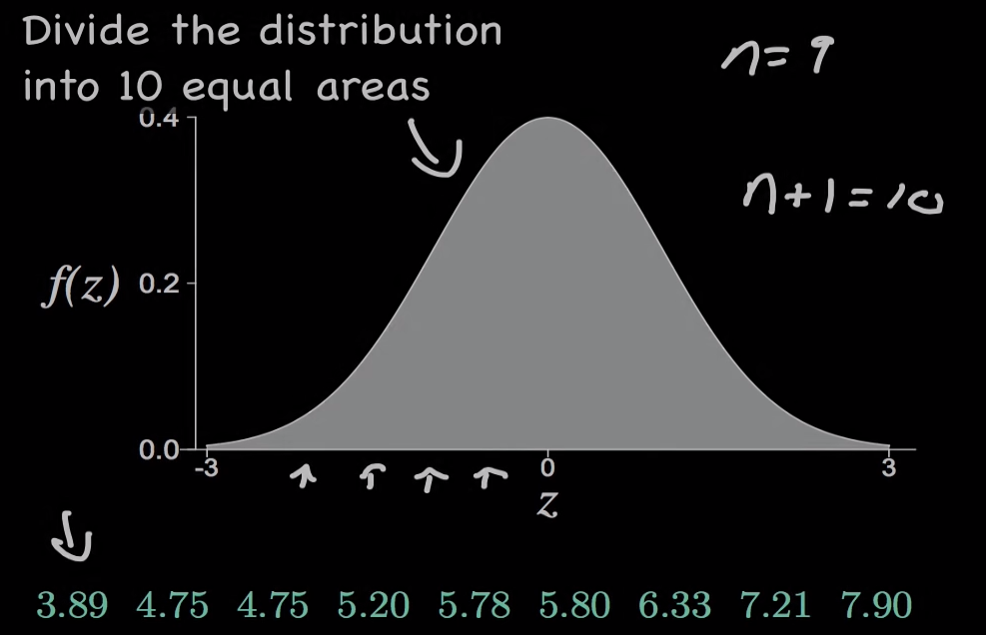
QQ Plot

Slide 14
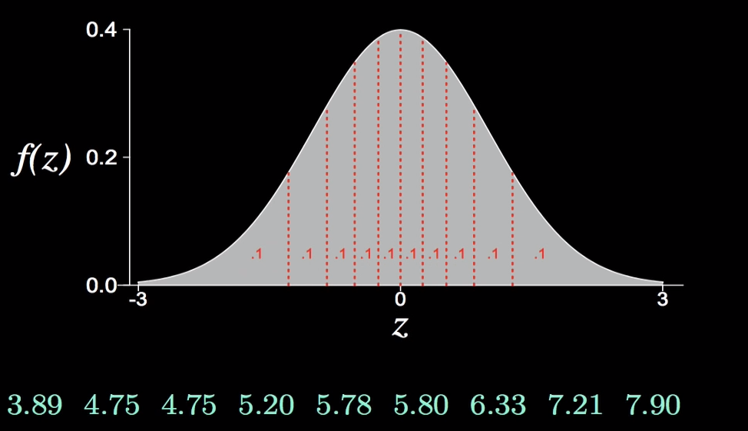
QQ Plot

Slide 15
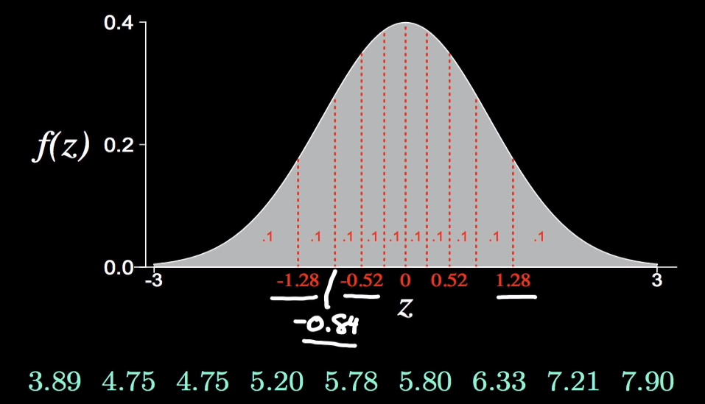
QQ Plot

Slide 16
QQ Plot
Now Plot 3.89 against -1.28, 4.75 against -0.84………….. and 7.90 against 1.28.

Slide 17
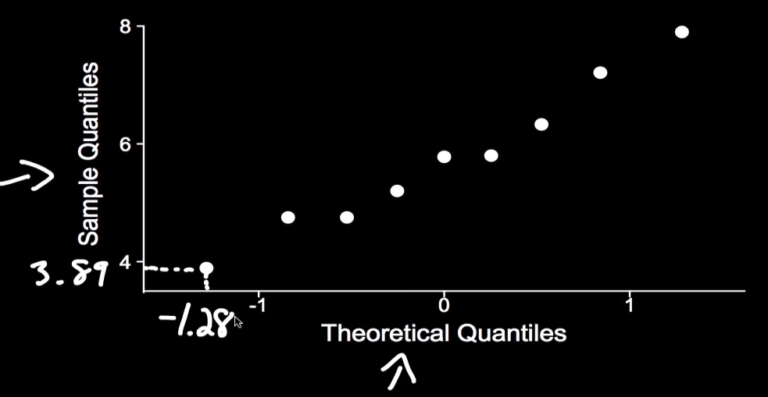
QQ Plot
Now Plot 3.89 against -1.28, 4.75 against -0.84………….. and 7.90 against 1.28.

Slide 18
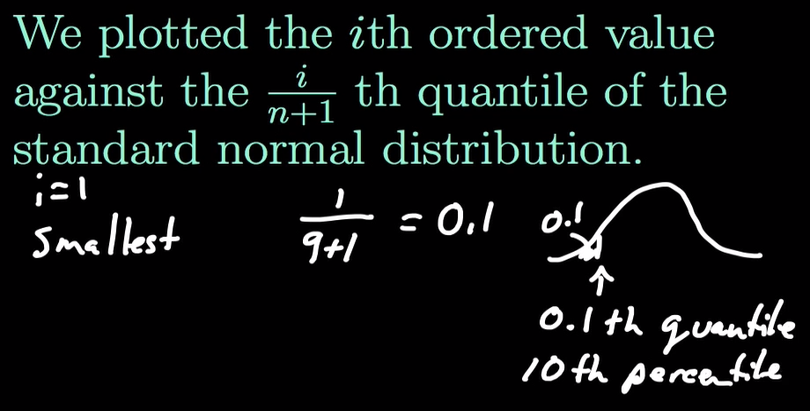
QQ Plot

Slide 19
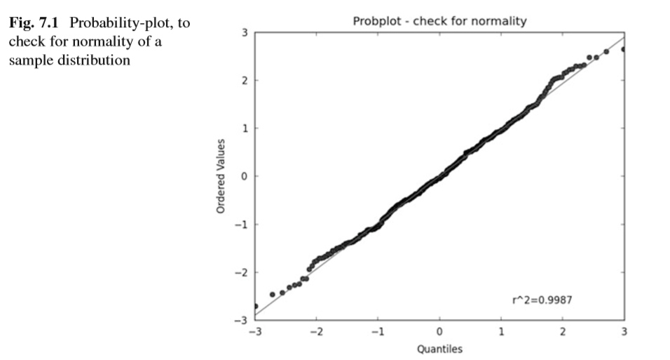
Probability Plot
In Python, a probability plot can be generated with the command
stats.probplot(data, plot=plt)

Slide 20
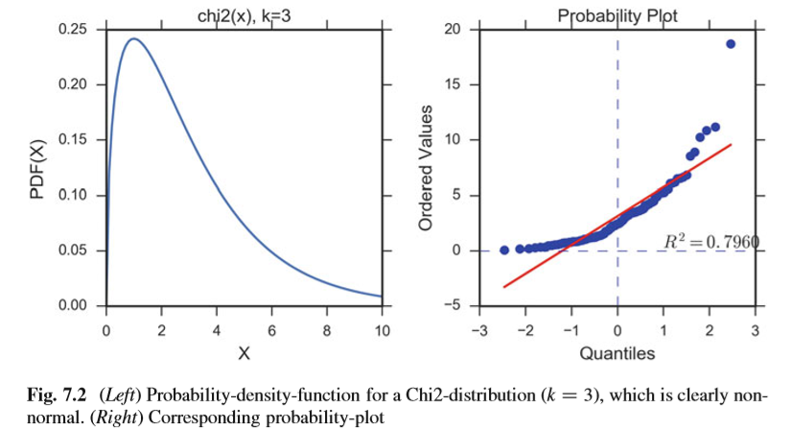
Probability Plot

Slide 21
Similar or not
In all three cases the results are similar:
if the two distributions being compared are similar, the points will approximately lie on the line y=x.
If the distributions are linearly related, the points will approximately lie on a line, but not necessarily on the line y=x

Slide 22
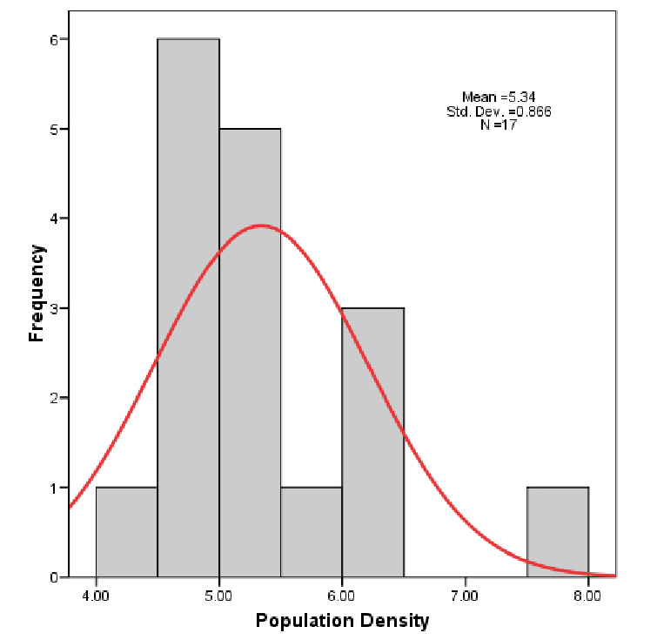
Drawbacks of Graphical plots
Graphical methods are typically not very useful when the sample size is small.
Consider this is a histogram example.
These data do not ‘look’ normal, but they are not statistically different than normal.

Slide 23
Statistical Tests for Normality check
These tests can be broadly divided into two categories:
Tests based on comparison (“best ﬁt”) with a given distribution, often speciﬁed in terms of its CDF.
The Kolmogorov–Smirnovtest,
The Lilliefors test,
The Anderson–Darling test,
The Cramer–von Mises criterion,
The Shapiro–Wilk
TheShapiro–Franciatests.
Tests based on descriptive statistics of the sample.
The skewness test,
The kurtosis test
The D’Agostino–Pearson omnibus test
The Jarque–Bera test.

Slide 24
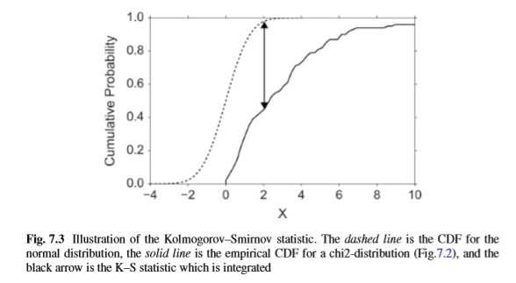
Statistical Tests for Normality check

Slide 25
Statistical Tests for Normality check
The Lilliefors test, which is based on the Kolmogorov–Smirnov test, quantiﬁes a distance between the empirical distribution function of the sample and the cumulative distribution function of the reference distribution, or between the empirical distribution functions of two samples.
(The original Kolmogorov– Smirnov test should not be used if the number of samples is <=300.)
The Shapiro–Wilk W test, which depends on the covariance matrix between the order statistics of the observations, can also be used with <=50 samples.
The Python command stats.normaltest(x) uses the D’Agostino–Pearson omnibus test.
This test combines a skewness and kurtosis test to produce a single, global “omnibus” statistic.

Slide 26
Data Transformation
If the data deviate signiﬁcantly from a normal distribution, it is sometimes possible to make the distribution approximately normal by transforming the data.
For example, data often have values that can only be positive (e.g., the size of persons), and that have long positive tail: such data can often be made normal by applying a log transform.

Slide 27
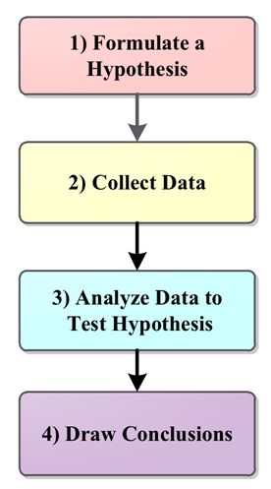
Hypothesis
A hypothesis is an educated prediction that can be tested.
A hypothesis is a specific, testable prediction.
A hypothesis is used in an experiment to define the relationship between two variables.
Examples
If I replace the battery in my car, then my car will get better gas mileage.
If I eat more vegetables, then I will lose weight faster.
If I add fertilizer to my garden, then my plants will grow faster.
If I brush my teeth every day, then I will not develop cavities.
If I take my vitamins every day, then I will not feel tired.
If 50 mL of water are added to my plants each day and they grow, then adding 100 mL of water each day will make them grow even more.

Slide 28
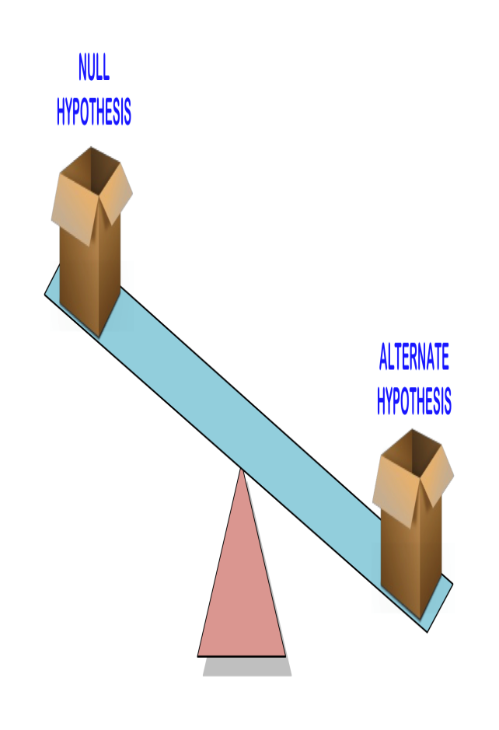
Hypothesis
Null Hypothesis:
A null hypothesis is a hypothesis that says there is no statistical significance between the two variables.
It is usually the hypothesis a researcher or experimenter will try to disprove or discredit.
Alternative Hypothesis:
Analternative hypothesis is one that states there is a statistically significant relationship between two variables.
The alternate hypothesis is simply the opposite of the null hypothesis

Slide 29
Hypothesis Concept Example
Assume that you are running a private educational institution.
Your contract says that if your students score 110 in the ﬁnal exam, where the national average is 100, you get a bonus.
When the results are signiﬁcantly lower, you loose your bonus (because the students are not good enough), and you have to hire more teachers;
and when the results are signiﬁcantly higher, you also loose your bonus (because you have spent too much money on teachers), and you have to cut back on the number of teachers.

Slide 30
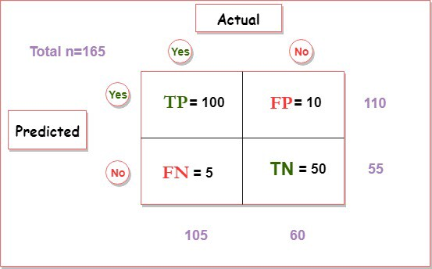
Types of Error
In hypothesis testing, two types of errors can occur.
Type I Errors
Type II Errors

Slide 31
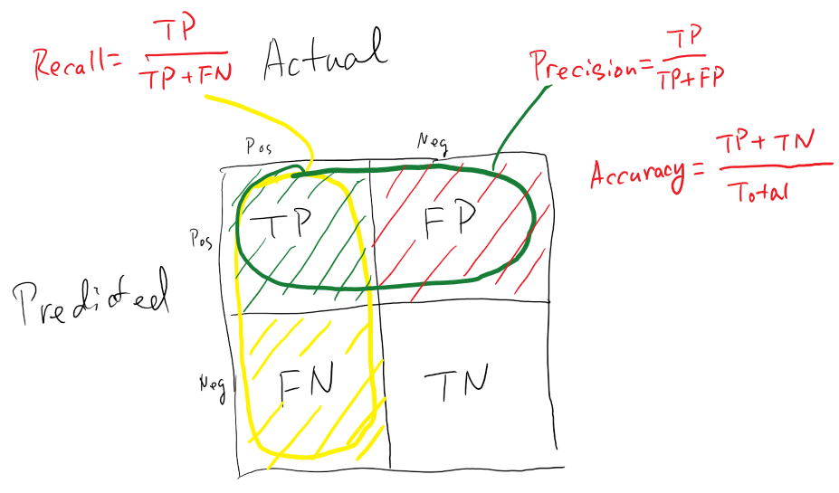
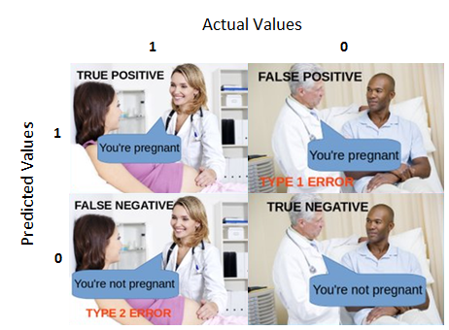
Evaluation metrics

Slide 32
Evaluation metrics

Slide 33
Types of Error: Type I
Type I errors are errors where the result is signiﬁcant despite the fact that the null hypothesis is true.
The likelihood of a Type I error is commonly indicated with α, and is set before the start of the data analysis.
In quality control, a Type I error is called producer risk, because you reject a produced item despite the fact that it meets the regulatory requirements
Ex: a Type I error would be a diagnosis of cancer (“positive” test result), even though the subject is healthy.

Slide 34
Types of Error: Type II
Type II errors are errors where the result is not signiﬁcant, despite the fact that the null hypothesis is false.
In quality control, a Type II error is called a consumer risk, because the consumer obtains an item that does not meet the regulatory requirements.
TypeII error would be a “healthy”diagnosis (“negative” test result), even though the patient has cancer.
The probability for this type of error is commonly indicated with β.
The“power” of a statistical test is deﬁned as (1- β) *100 , and is the chance of correctly accepting the alternative hypothesis.

Slide 35
Sensitivity and Speciﬁcity
Sensitivity: Also called power. Proportion of positives that are correctly identiﬁed by a test (= probability of a positive test, given the patient is ill).
Speciﬁcity: Proportion of negatives that are correctly identiﬁed by a test (=probability of a negative test, given that patient is well).
Positive PredictiveValue (PPV): Proportion of patients with positive test results who are correctly diagnosed.
NegativePredictiveValue (NPV): Proportion of patients with negative test results who are correctly diagnosed.

Slide 36
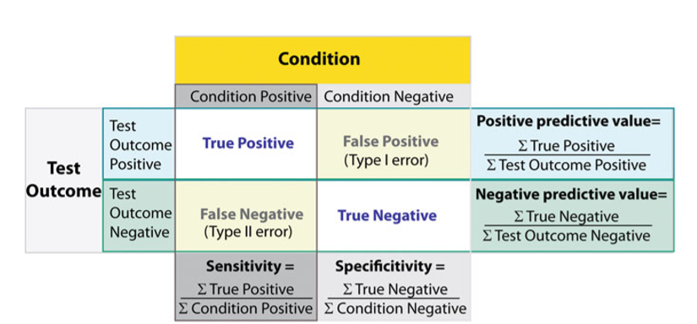
Sensitivity and Speciﬁcity
]\\

Slide 37
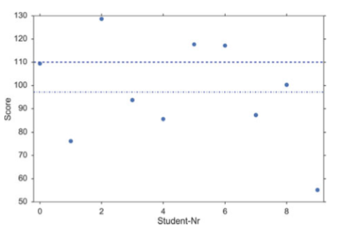
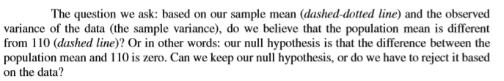
Hypothesis Concept Example
The ﬁnal exam of your ten students produce the following scores:
scores = np.array([ 109.4, 76.2, 128.7, 93.7, 85.6, 117.7, 117.2, 87.3, 100.3, 55.1])

